Slide 1
Demand Analysis
Unit-II

Slide 2
DEMAND ANALYSIS
Demand:
Every want supported by willingness and ability to buy constitutes demand for a particular product of or service.
A product or service is said to have demand when three conditions are satisfied.
1. Desire on the part of the buyer to buy
2. Willingness to pay for it
3. Ability to pay the specified price for it
Demand = Desire+ Willingness + Ability to pay

Slide 3
Law of Demand
The law of demand states: Other things remaining the same, the amount of quantity demanded rises with every fall in the price and vise versa.
The law of demand states the relationship between price and demand of particular product of service.
It makes an assumption that all other determinants remain the same or do not change.

Slide 4
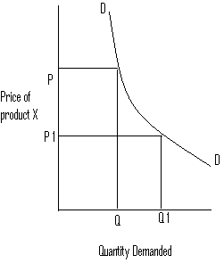
Operation of Law of Demand
The law of demand explains that every fall in the price of particular product, its demand goes on increasing and vise versa.

Slide 5
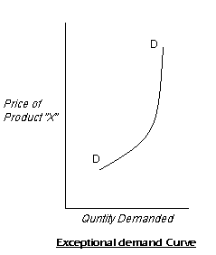
Exceptions of Law of Demand
Exceptions:
Where there is a shortage of necessities feared:
Where the product is such that it confers distinction:
Ex: Gold, Jewels
Giffen’s Paradox:
Ex: Broken rice
Incase of ignorance of price changes:

